Slide 1
TRIGGERS FOR MAINTENANCE TESTING

Slide 2



TRIGGERS
Maintenance testing is done on an existing operational system. It is triggered by modifications, migration, or retirement of the system.

Slide 3


Planned Enhancement Changes
Release-based
MODIFICATIONS
Corrective and Emergency Changes
Changes of Environment
Planned Operating System (OS) Upgrades
Database Upgrades
Patches to Newly Exposed
Discovered Vulnerabilities of OS

Slide 4


Operational Testing of The
New Environment
MIGRATIONS
Operational Testing of The Changed Software

Slide 5


The Testing of Data Migration
RETIREMENT
The Testing of Data Archiving

Slide 6


MODIFICATIONS ARE OFTEN THE MAIN PART OF MAINTENANCE TESTING FOR MOST ORGANIZATIONS
MODIFICATIONS
PLANNED
AD-HOC
CORRECTIVE

Slide 7

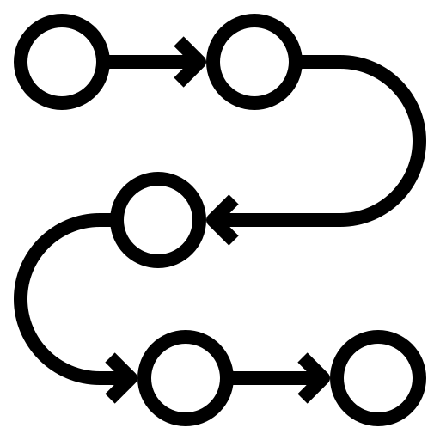
Perfective Modifications
Adaptive Modifications
Corrective Planned Modifications
Average, planned modification represents over
PLANNED
%
66339120232725243799982582740515176782194791891294126090
of all maintenance work on systems.
Notes:
perfective modifications (adapting software to the user's wishes, for instance by supplying new functions or enhancing performance)
adaptive modifications (adapting software to environmental changes such as new hardware, new systems software or new legislation)
corrective planned modifications (deferrable correction of defects).

Slide 8
MODIFICATIONS ARE OFTEN THE MAIN PART OF MAINTENANCE TESTING FOR MOST ORGANIZATIONS
MODIFICATIONS
PLANNED
AD-HOC
CORRECTIVE

Slide 9
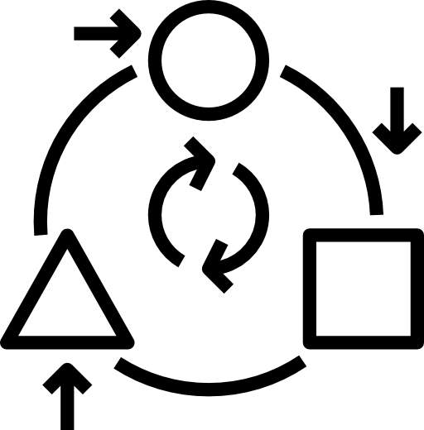
Ad-hoc corrective modifications are concerned with defects requiring an immediate solution
It will be impossible to take the steps required for a structured approach to testing.
To some extent this type of maintenance testing is often like first aid, patching up, and at a later stage the standard test process is then followed to establish a robust fix, test it and establish the appropriate level of documentation
AD-HOC CORRECTIVE
Notes:
perfective modifications (adapting software to the user's wishes, for instance by supplying new functions or enhancing performance)
adaptive modifications (adapting software to environmental changes such as new hardware, new systems software or new legislation)
corrective planned modifications (deferrable correction of defects).

